Slide 1


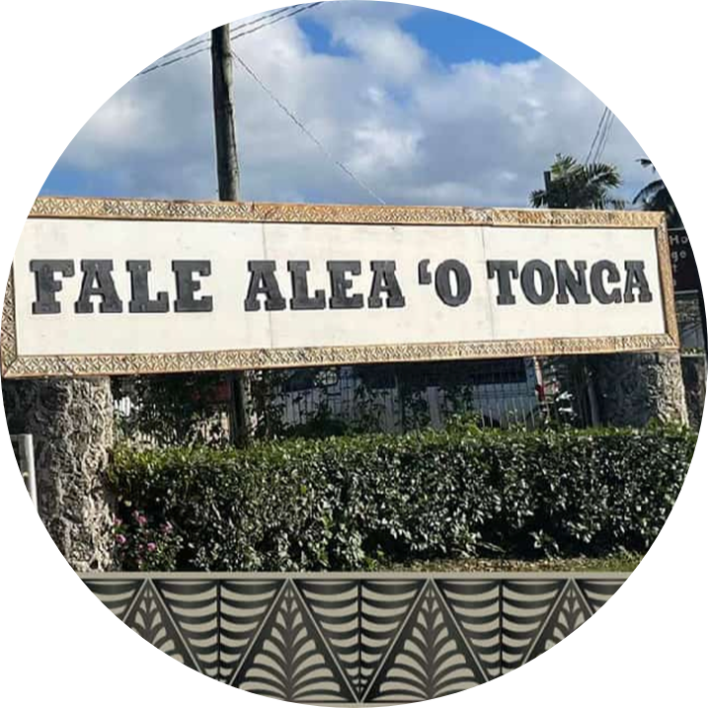
Budget Estimates & Statement
“Accelerate delivery of vital Government initiatives to generate sustainable, inclusive growth.”
Ministry of Finance
May 2026

Slide 2
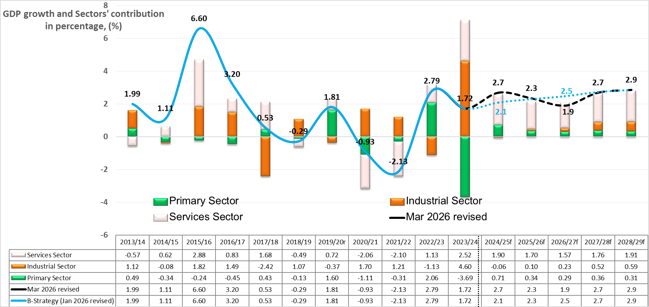
Global Outlook
The global economy is in a state of high uncertainty following the ongoing conflict in the Middle East and its impact on the energy markets.
The IMF projections assumes energy disruptions are temporary, and prices are expected to ease mid-2026 with global growth remaining stable at 3.1 percent in 2026.
Domestic outlook
Tonga’s economic growth forecast for FY2027 has been revised down to 1.9% compared to an earlier projection of 2.5% - reflecting growing external pressures.
Over the medium term FY2027-FY2029, economic growth is expected to recover to an average of 2.5%, supported by accelerated project implementation, increased construction activity, and easing external price pressures.

Slide 3
Fiscal Policy & Status
Government aims to maintain fiscal stability in the face of external shock
Revenue is projected to respond as risk of fluctuating external flow has heightened.
Expense is also projected to decline at a rate of -1 percent in the medium term to respond to revenue risk.
Debt Portfolio Summary
As at 30th June 2026, Tonga’s total disbursed outstanding public debt is projected at $406.2m, equivalent to 23.4 percent of GDP. External public debt is projected to decline by $2.9m by the end of June 2026, primarily due to the external debt repayments. Domestic debt repayments are fully offset by rollovers, with new issuance of Government Bond $30m anticipating being fully issued by end of June 2026.

Slide 4
Budget for the Medium Term (FY2027-FY2029)
This is a summary of the Budget and its financing of the budget deficit of $18 million.

Slide 5
Revenue by MDA:

Slide 6
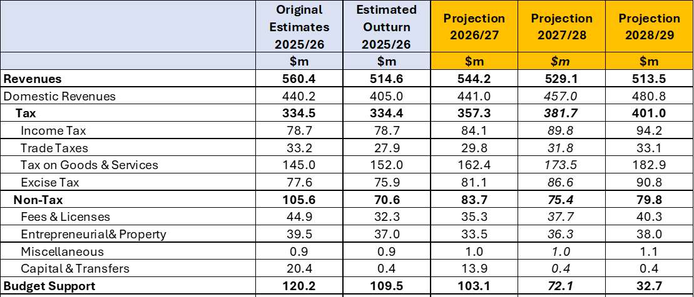
Revenue by category:

Slide 7
Expenditure by MDA:

Slide 8
Expenditure by MDA:

Slide 9
Expenditure allocation by Ministry from Donor Fund:

Slide 10
Allocation by Location Donor Fund:

Slide 11
Fuel & Energy crisis response
To enhance fiscal resilience and ensure preparedness for emerging risk,
The Government has identified financing options of $49.6m to support emergency response measures related to fuel disruptions and other unforeseen events – as detailed in Table 1.
Other Donors – Amounts yet to be confirmed, pending national plans to be completed

Slide 12
Recommendations
That the following recommendations are respectfully submitted for consideration by Hon Cabinet Ministers:
That the attached ‘Draft Budget Statement Summary’ and the Draft Budget Estimate total of $953.3m, comprising $582.1m recurrent and $371.2m development, be approved.
That the Appropriate Cash of $740.7m to the service of Government for FY2027, be noted.
That the proposed allocation to support the implementation of activities under each of the seven (7) strategic focus areas, be noted.
That the ‘Draft Budget Statement Summary and ‘Draft Budget Estimates FY2027 with the Appropriation Bill be submitted to the Legislative Assembly, be approved.

Slide 13
Malo ‘aupito

